Slide 1

Modeling Farmers' Income: Key Economic Determinants

Slide 2
INTRODUCTION
Agriculture plays a crucial role in the economic stability of many countries, particularly in regions where farming is the primary source of livelihood. In West Bengal, India, rice farming is a major agricultural activity, and farmers' annual income is influenced by various economic, environmental, and policy-driven factors. Understanding these influences can help policymakers and stakeholders develop effective strategies to improve farmers' financial stability. This study aims to predict farmers' annual income using a linear regression model based on key determinants such as land size, farming experience, irrigation type, crop loss, weather impact, fertilizer usage, government subsidies, loan amount taken, interest rate of loans, and market price per kilogram of produce. By identifying the most significant predictors of income, this study seeks to provide insights into financial planning and agricultural development policies.
This study was conducted using SPSS software, which facilitated data processing, statistical analysis and model building to derive meaningful insights from the dataset.

Slide 3
OBJECTIVES
To analyze the relationship between various agricultural and economic factors with farmers' annual income.
To develop a linear regression model that accurately predicts farmers' earnings based on selected economic and agricultural variables.
To assess the impact of financial support mechanisms, such as subsidies and loans, on farmers' financial well-being.
To provide data-driven recommendations for policymakers to improve farmers' income stability.

Slide 4
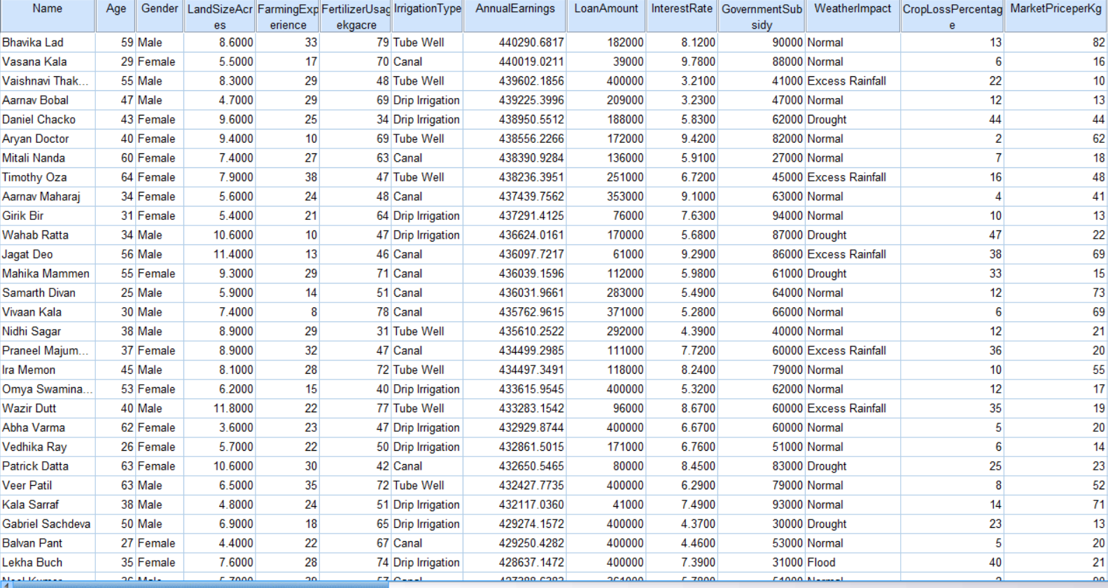
METHODOLOGY AND DATA
DATA COLLECTION
This study utilizes secondary data obtained from Kaggle, containing records of rice farmers from West Bengal who took loan and received subsidies from the government for the year 2022. The dataset comprises a combination of categorical and numerical variables that capture various aspects of farmers' financial and agricultural conditions. The variables include “Name”, “Age”, “Gender”, “Annual earnings”, “Farming experience”, “Crop loss percentage”, “Land size in acres”, “Loan amount”, “Interest rate”, “Government subsidy” and “Market price per kg”, “Fertilizer usage”, “Irrigation type”, “Weather impact” .

Slide 5
2. RESEARCH DESIGN
This study employs a quantitative research approach using a predictive modeling framework to analyze the impact of financial support mechanisms, such as government subsidies and loans, on farmers' annual earnings.
3. DATA PREPROCESSING
Handling Missing Values: Missing values are identified and treated using mean computation for numerical variables.
Converting Categorical Variables: categorical variables are converted into numerical representations to be included as predictors
Identifying and Correcting Inconsistent Data: The logical inconsistencies in the data were identified and corrected if necessary.
Transforming Skewed Variables: Transforming skewed data improves the accuracy of regression modeling by meeting normality assumptions.
Outlier Detection & Treatment: Outliers are identified using Z-score analysis and Cook’s Distance method and either transformed or removed if necessary.
4. EXPLORATORY DATA ANALYSIS (EDA)
Summary statistics (mean,standard deviation) are computed.
Correlation analysis is performed to check multicollinearity between predictors.
Histograms are used to visualize variable distributions and detect anomalies.
Scatter plots are created to explore the relationships between variables.

Slide 6
6. MODEL DEVELOPMENT
A multiple linear regression model was constructed to assess the influence of independent variables, including land size, farming experience, loan amount, interest rate, government subsidy, and market price per kilogram, on farmers' earnings.
The dataset was split into training (90%) and test (10%) sets to validate model performance.
The regression model was built using the training dataset, and the estimated coefficients were used to predict farmers' earnings in the test dataset.
6. EVALUATION OF MODEL PERFORMANCE
Residual analysis was conducted to check the normality, homoscedasticity, and independence of residuals.
The histogram and Q-Q plot confirmed that the residuals were approximately normally distributed.
The model was applied to the test dataset, and the predicted values were compared with actual values to assess its predictive accuracy.
7. FINDINGS AND POLICY RECOMMENDATIONS
Data-driven recommendations will be provided for policymakers to improve farmers' income stability by optimizing subsidy allocations, refining loan policies, and identifying alternative measures to enhance economic resilience.

Slide 7
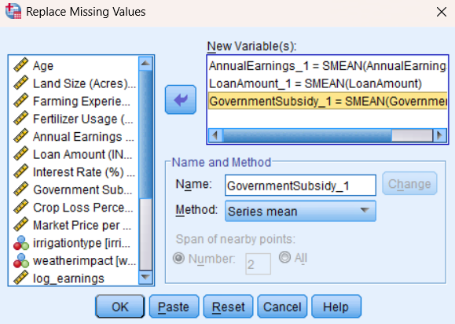
Handling missing values
Statistics
 |  | Name | Age | Gender | Irrigation Type | Weather Impact | Land Size (Acres) | Farming Experience (Years) | Fertilizer Usage (kg/acre) | Annual Earnings (INR) | Loan Amount (INR) | Interest Rate (%) | Government Subsidy (INR) | Crop Loss Percentage (%) | Market Price per Kg (INR)
N | Valid | 7624 | 7624 | 7624 | 7624 | 7624 | 7624 | 7624 | 7624 | 7618 | 7603 | 7624 | 7586 | 7624 | 7624
 | Missing | 0 | 0 | 0 | 0 | 0 | 0 | 0 | 0 | 6 | 21 | 0 | 38 | 0 | 0
Annual Earnings has 7618 valid values and 6 values were missing.
Loan Amount has 7603 valid values and 21 values were missing.
GovernmentSubsidy has 7586 values and 38 values were missing.
Since these are numerical variables, the missing values can be replaced using the mean.

Slide 8
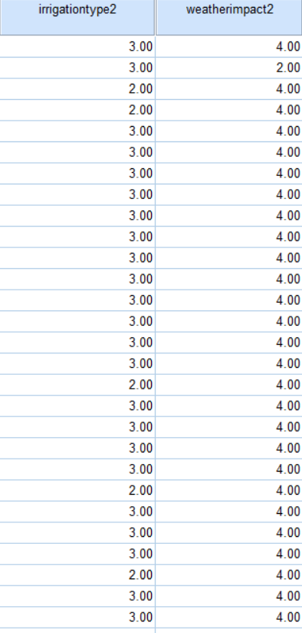
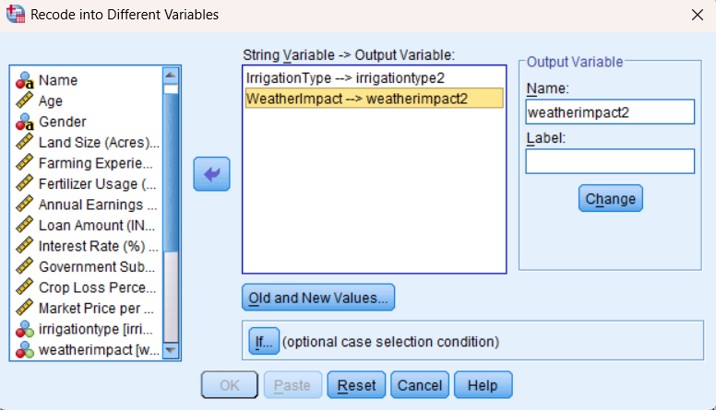
Converting Categorical Variables
In this study, two categorical variables—Weather Impact and Irrigation Type—are included in the dataset. Since regression analysis requires numerical inputs, these categorical variables were converted into numerical form using dummy coding in SPSS.
Weather Impact
Flood : 1
Drought : 2
Excess Rainfall : 3
Normal : 4
Pest Attack : 5
Irrigation Type
Tube Well : 1
Drip Irrigation : 2
Canal : 3

Slide 9
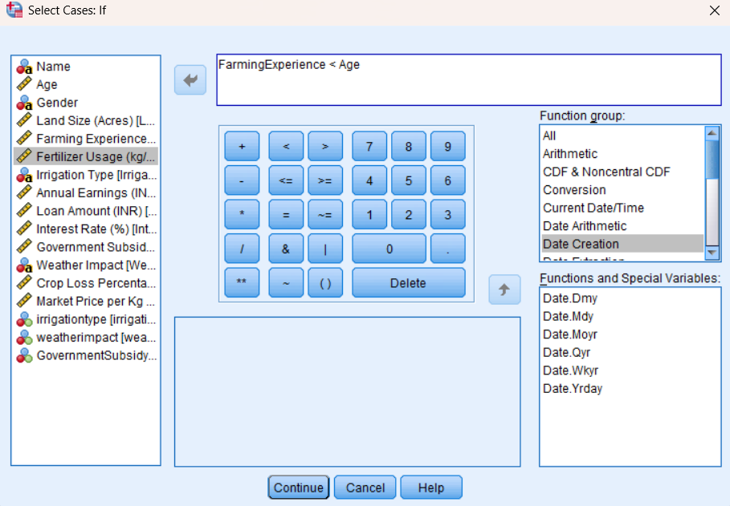
Identifying and Correcting Inconsistent Data
A logical inconsistency was identified in Farming Experience, where in some cases, the reported farming experience exceeded the farmer’s age, which is not possible.
This command will filter out the cases where Farming Experience is greater than Age and keep only valid records.

Slide 10
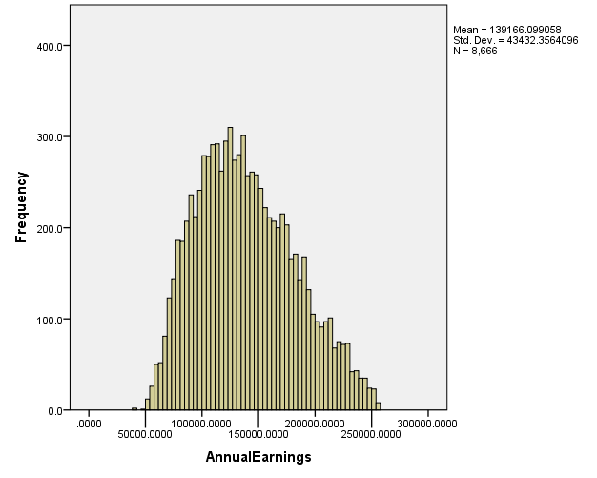
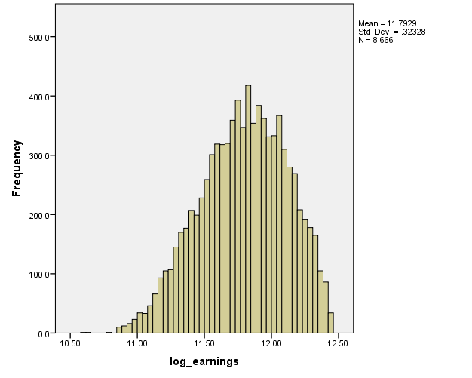
Checking for Normality
Histogram of Annual earnings
This histogram of AnnualEarnings looks roughly normal,
it appears slightly right-skewed (longer tail on the right)
After log-transformation
This log-transformed histogram of AnnualEarnings appears slightly left-skewed,(longer tail on the left)

Slide 11
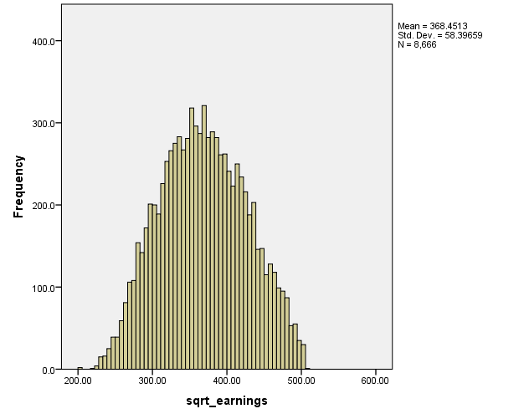
After square-root transformation
The histogram of square-root transformed AnnualEarnings appears to be normal.
The regression model will be developed using the square-root transformed Annual Earnings variable to improve normality, reduce skewness, and enhance the reliability of statistical inferences.

Slide 12
Descriptive statistics
Descriptive Statistics
 | N | Minimum | Maximum | Mean | Std. Deviation
LandSizeAcres | 7547 | 2.0000 | 15.0000 | 8.356666 | 3.7048698
FarmingExperience | 7547 | 5 | 39 | 21.98 | 10.103
FertilizerUsagekgacre | 7547 | 30 | 79 | 54.48 | 14.294
AnnualEarnings | 7547 | 36084.2583 | 256120.6001 | 139108.953537 | 43499.6408441
LoanAmount | 7547 | 19000 | 400000 | 126219.26 | 144797.607
InterestRate | 7547 | .0000 | 11.5700 | 3.678357 | 3.6585576
GovernmentSubsidy | 7547 | 5000 | 97000 | 21459.73 | 33272.624
CropLossPercentage | 7547 | 0 | 49 | 17.06 | 14.199
MarketPriceperKg | 7547 | 10 | 99 | 41.25 | 24.359
irrigationtype2 | 7547 | 1 | 3 | 2.01 | .807
weatherimpact2 | 7547 | 1 | 5 | 3.55 | 1.082
sqrt_earnings | 7547 | 202.17 | 506.08 | 367.8144 | 58.0939
Valid N (listwise) | 7547

Slide 13
Correlation Table
 |  | sqrt_earnings | LandSizeAcres | FarmingExperience | FertilizerUsagekgacre | CroplossPercentage | weatherimpact2 | irrigationtype2 | LoanAmount | InterestRate | GovernmentSubsidy | MarketPriceperKg
Pearson Correlation | sqrt_earnings | 1.000 | .463 | .21 | .07 | -.164 | -.063 | .008 | .37 | -.29 | .597 | .27
 | LandSizeAcres | .463 | 1.000 | .203 | .054 | .006 | .049 | .004 | .063 | .031 | .019 | -.006
 | FarmingExperience | .21 | .203 | 1.000 | .045 | .012 | .021 | .127 | .002 | .03 | .029 | .007
 | FertilizerUsagekgacre | .07 | .054 | .045 | 1.000 | .112 | .032 | .121 | .036 | .021 | .872 | .698
 | CroplossPercentage | -.164 | .006 | .012 | .112 | 1.000 | .678 | .032 | .621 | .007 | .035 | .012
 | weatherimpact2 | -.063 | .049 | .021 | .032 | .678 | 1.000 | .007 | .025 | .112 | .032 | .001
 | irrigationtype2 | .008 | .004 | .127 | .121 | .032 | .007 | 1.000 | .087 | .097 | .036 | .021
 | LoanAmount | .37 | .063 | .002 | .036 | .621 | .025 | .087 | 1.000 | .207 | -.096 | .002
 | InterestRate | -.29 | .031 | .03 | .021 | .007 | .112 | .097 | .207 | 1.000 | .022 | .001
 | GovernmentSubsidy | .597 | .019 | .029 | .872 | .035 | .032 | .036 | -.096 | .022 | 1.000 | -.012
 | MarketPriceperKg | .27 | -.006 | .007 | .698 | .012 | .001 | .021 | .002 | .001 | -.012 | 1.000

Slide 14
Correlation analysis
Correlation with sqrt_earnings (Target Variable)
GovernmentSubsidy (0.597): The highest positive correlation, indicating that government subsidies strongly influence earnings.
LandSizeAcres (0.463): A moderate positive correlation, meaning that larger land sizes are associated with higher earnings.
LoanAmount (0.37): A moderate positive correlation, suggesting that higher loan amounts contribute to increased earnings.
MarketPriceperKg (0.27): A low positive correlation, implying that higher market prices for crops slightly increase earnings.
FarmingExperience (0.21): A low positive correlation, meaning experience has an impact on earnings.
InterestRate (-0.29): A negative correlation, indicating that higher interest rates are linked to lower earnings, possibly due to increased loan repayment burdens.
Irrigation Type (0.008) : Almost no correlation with earnings.
Weather Impact (-0.063) : Very weak correlation.
Crop Loss Percentage (-0.164) : Weak correlation.
Fertilizer Usage (0.07) : Very Weak correlation.
These variables that exhibit a very weak correlation with the dependent variable (sqrt_earnings) are not considered for model building.

Slide 15
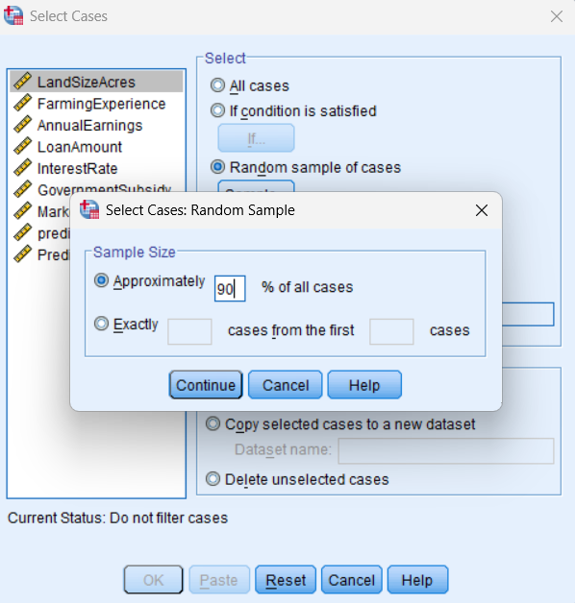
Data splitting for model development
To ensure the robustness and generalizability of the regression model, the dataset was split into training and test sets. A 90:10 split ratio was chosen, where 90% of the data was used for training the model, and the remaining 10% was reserved for testing.
The training dataset was used to build and optimize the regression model by identifying relationships between the independent variables and the square-root transformed Annual Earnings variable. The test dataset was kept separate to evaluate the model’s performance on unseen data, preventing overfitting and ensuring the model’s predictive power in real-world scenarios.
This approach aligns with standard machine learning and statistical modeling practices, ensuring that the model learns effectively from the training data while being able to make accurate predictions on new observations.

Slide 16
Model development
Model Summary
Model | R | R Square | Adjusted R Square | Std. Error of the Estimate
1 | .927ª | .859 | .859 | 21.82991
Predictors: (Constant), MarketPriceperKg, InterestRate, LandSizeAcres, GovernmentSubsidy, FarmingExperience, LoanAmount
b. Dependent Variable: sqrt_earnings
R = 0.927 → Indicates a high correlation between the predictors and the dependent variable (sqrt_earnings).
R² = 0.859 → Suggests that 85.9% of the variance in sqrt_earnings is explained by the independent variables, which is a strong model fit.
Adjusted R² = 0.859 → Since it's nearly the same as R², it means that adding predictors hasn't introduced unnecessary complexity.
Standard Error of the Estimate (21.82991) → Measures the typical deviation of observed values from the predicted values.
ANOVAª
Model |  | Sum of Squares | Df | Mean Square | F | Sig.
1 | Regression | 22432243.311 | 6 | 3738707.218 | 7845.447 | .000^{b}
 | Residual | 3674160.616 | 6598 | 476.545
 | Total | 26106403.927 | 6604
a. Dependent Variable: sqrt_earnings
b. Predictors: (Constant), MarketPriceperKg, InterestRate, LandSizeAcres, GovernmentSubsidy, FarmingExperience, LoanAmount
F-Statistic = 7845.44
Significance Level (Sig.) = 0.000
The p-value (< 0.05) confirms that the regression model is highly significant, meaning that the predictor variables collectively have a strong relationship with sqrt_earnings.

Slide 17
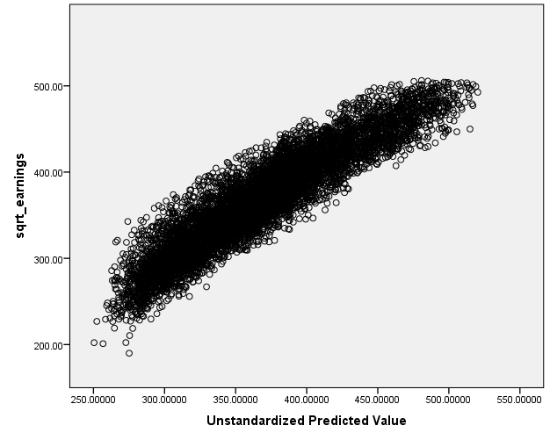
Scatter Plot (Predicted vs. Transformed Earnings)
The scatter plot shows a strong linear pattern, indicating a good fit of the regression model. However, there are a few points that deviate from the main cluster, especially at the lower and upper ends of the predicted values. These could be potential outliers, these outliers have to be identified and the model has to be re-estimated using the refined dataset, ensuring improved accuracy and reliability in predicting farmers’ annual earnings.

Slide 18
Outlier detection and removal
Outliers are data points that deviate significantly from the pattern of the rest of the data. They can distort statistical analyses, affect regression coefficients, and reduce the accuracy of predictive models. In regression analysis, two effective methods for detecting and removing outliers are Standardized Residuals and Cook’s Distance.
A residual is the difference between the observed and predicted values of the dependent variable. Standardized residuals (ZRESID) are residuals that have been transformed into a standard normal distribution with a mean of 0 and a standard deviation of 1.
In general:
If |Standardized Residual| > 3, the observation is considered an outlier.
Cook’s Distance measures the influence of an individual data point on the overall regression model. It assesses how much the fitted values would change if that data point were removed.
A high Cook’s Distance value suggests that the point is highly influential and could be distorting the model.
The common rule is:
If Cook’s Distance > 1, the observation is influential and should be examined.

Slide 19
After outlier removal,
Model Summary^{b}
Model | R | R Square | Adjusted R Square | Std. Error of the Estimate
1 | .933ª | .871 | .871 | 20.90493
a. Predictors: (Constant), MarketPriceperKg, InterestRate, LandSizeAcres, FarmingExperience, GovernmentSubsidy, LoanAmount
b. Dependent Variable: sqrt_earnings
ANOVAª
Model |  | Sum of Squares | df | Mean Square | F | Sig.
1 | Regression | 22398146.549 | 6 | 3733024.425 | 8542.071 | .000^{b}
 | Residual | 3328753.158 | 5705 | 437.016
 | Total | 25726899.707 | 5711
a. Dependent Variable: sqrt_earnings
b. Predictors: (Constant), MarketPriceperKg, InterestRate, LandSizeAcres, FarmingExperience, GovernmentSubsidy, LoanAmount
The new updated model summary shows an R² of 0.871, which means that 87.1% of the variance in the square-root-transformed earnings is explained by the predictor variables. This is an improvement from the previous model (R² = 0.859). The standard error of the estimate (20.90) has also slightly decreased, indicating better model precision.

Slide 20
Coefficientsª
Model |  | Unstandardized Coefficients |  | Standardized Coefficients | t | Sig. | Collinearity Statistics
 |  | B | Std. Error | Beta |  |  | Tolerance | VIF
1 | (Constant) | 231.625 | .951 |  | 243.457 | .000
 | LandSizeAcres | 8.899 | .065 | .566 | 137.224 | .000 | .947 | 1.053
 | FarmingExperience | .752 | .024 | .131 | 31.741 | .002 | .971 | 1.029
 | LoanAmount | .02 | .001 | .271 | 49.236 | .000 | .681 | 1.321
 | InterestRate | -1.858 | .087 | -.117 | -21.337 | .001 | .568 | 1.461
 | GovernmentSubsidy | .013 | .000 | .741 | 177.830 | .000 | .977 | 1.023
 | MarketPriceperKg | .246 | .011 | .103 | 25.066 | .001 | .912 | 1.103
a. Dependent Variable: sqrt_earnings
Significant Predictors (p-value < 0.05):
LandSizeAcres (p = .000)
FarmingExperience (p = .002)
LoanAmount (p = .000)
InterestRate (p = .001)
GovernmentSubsidy p = .000)
MarketPriceperKg (p = .001).
Multicollinearity (VIF Analysis):
VIF < 5 for all variables, indicating no serious multicollinearity issues.
Regression Equation:
sqrt_earnings^​=231.625+8.899(LandSizeAcres)+0.752(FarmingExperience)+0.02(LoanAmount)−1.858(InterestRate)+0.013 (GovernmentSubsidy)+0.246(MarketPriceperKg)

Slide 21
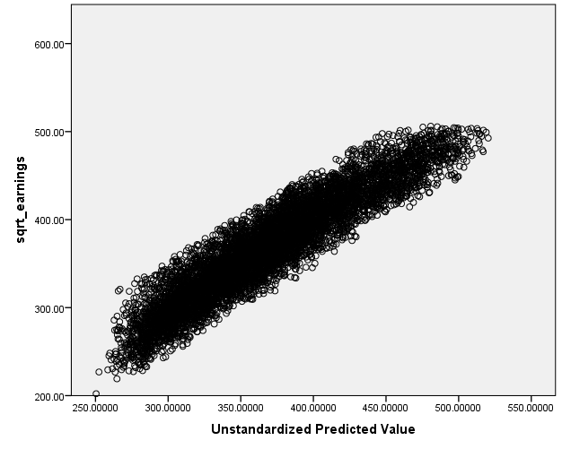
Scatter Plot (Predicted vs. Transformed Earnings) after outlier removal
The points remain closely clustered around a linear trend, further validating the model’s predictive strength.
The refined model shows less deviation at lower and upper earnings values, suggesting a more robust prediction across different earnings levels.
The spread of points appears more controlled and compact, with fewer extreme deviations, indicating improved homoscedasticity and better model fit.

Slide 22
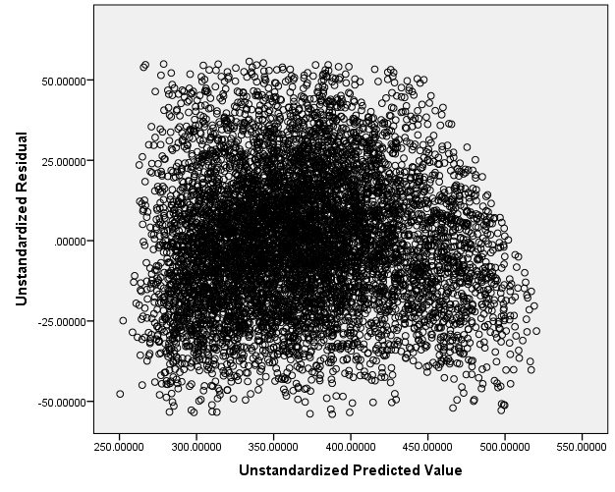
Residual Plot
Random Scatter (Good Sign)
The points appear randomly distributed around zero without any clear pattern.
This suggests that the model meets the assumption of homoscedasticity (constant variance of residuals).

Slide 23
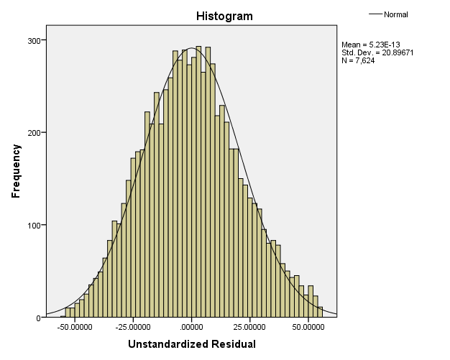
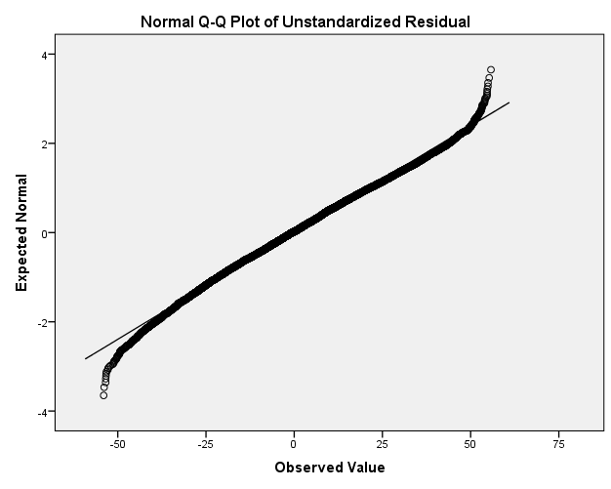
Residual normality checks
The histogram of residuals follows a symmetric normal shape.
The Q-Q plot shows an alignment with the normal distribution line, except for slight deviations at the tails.

Slide 24
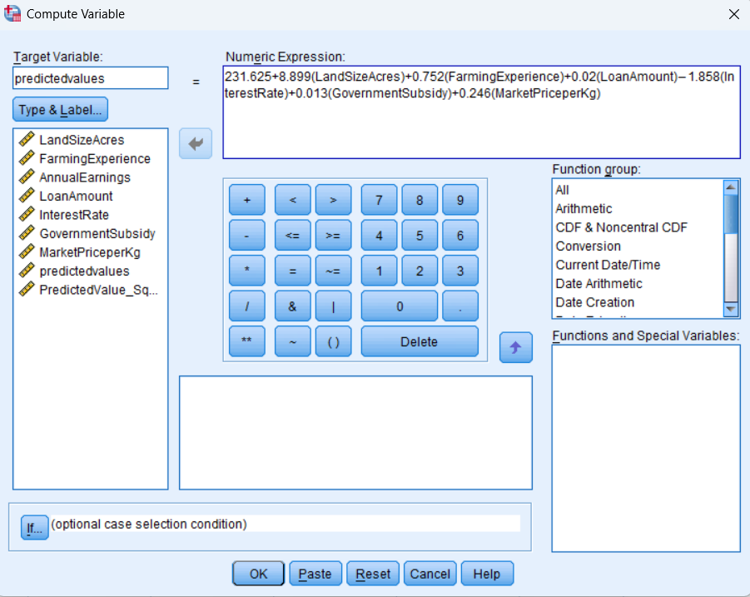
Applying the Model to the Test Data
Once the regression model was built using the training set, the estimated regression equation was applied to the testing dataset to generate predicted values for farmers' annual earnings.

Slide 25
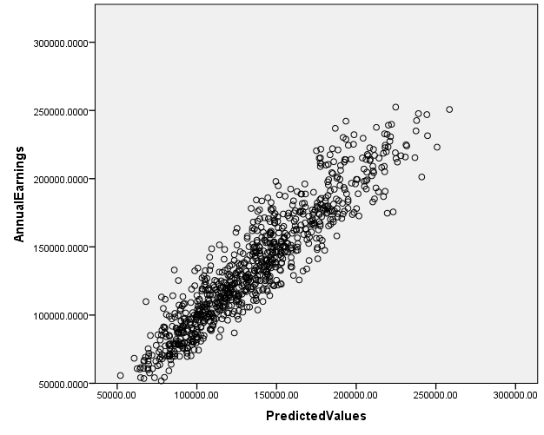
Applying the Model to the Test Data
Strong Positive Correlation
The data points form a tight cluster along a diagonal trend, suggesting that the model’s predicted values closely match the actual earnings.
This indicates that the model performs well on unseen data, confirming its predictive capability.

Slide 26
FINDINGS
The linear regression model was developed to predict farmers' annual earnings using key independent variables such as Land Size, Farming Experience, Loan Amount, Interest Rate, Government Subsidy, and Market Price per Kg. The major findings from the model are:
Strongest Predictors of Earnings
Government Subsidy (β = 0.741, p < 0.001)
This is the most influential variable in the model.
Higher government subsidies are strongly associated with increased earnings.
Land Size (β = 0.566, p < 0.001)
Larger farm sizes increase earnings significantly.
This suggests that farmers with more land have greater production capacity and income potential.
B. Moderate Predictors
Loan Amount (β = 0.271, p < 0.001)
Farmers who take larger loans tend to earn more, suggesting loans are being used effectively to boost productivity.
Farming Experience (β = 0.131, p = 0.002)
More experienced farmers have higher earnings, though the impact is relatively small.
Experience helps in better decision-making, but alone is not enough to significantly boost earnings.
Market Price per Kg (β = 0.103, p < 0.001)
While higher crop prices slightly increase earnings, this impact is relatively small.
Suggests that production volume and input costs might be more important than price fluctuations.
C. Negative Impact on Earnings
Interest Rate (β = -0.117, p = 0.001)
Higher interest rates reduce earnings, as loan repayments cut into farmers' profits.
This suggests that affordable credit options are necessary to improve farmer incomes.

Slide 27
Suggestions for Policy and Practical Implications
Based on the findings, the following recommendations are proposed:
1. Enhancing Government Subsidy Programs
Since government subsidies have the highest positive impact on earnings, authorities should increase the accessibility and efficiency of financial aid programs.
Implement direct benefit transfers (DBT) to ensure farmers receive subsidies on time and without intermediaries.
2. Expanding Access to Farmland
Policies should be designed to facilitate land consolidation and ease restrictions on leasing farmland.
Encourage cooperative farming models where small farmers pool resources and share profits.
3. Providing Affordable Credit Facilities
Since high interest rates negatively impact earnings, lower interest loan programs should be promoted for farmers.
Subsidized loan schemes or interest waivers for small farmers can help reduce financial burdens.
4. Improving Market Access and Pricing Policies
The relatively low impact of market prices on earnings suggests that farmers may not be getting fair prices.
Strengthen minimum support price (MSP) policies to protect farmers from price volatility.
Develop better storage and transportation infrastructure to help farmers reduce post-harvest losses and sell their produce at better prices.
5. Skill Development and Technology Adoption
Since farming experience plays a role in earnings, providing technical training and workshops on modern farming techniques can further improve productivity.
Promote the use of technology, precision farming, and efficient irrigation methods to optimize land use.

Slide 28
CONCLUSION
The regression analysis provides valuable insights into the key determinants of farmers' earnings. The major findings indicate that government subsidies, land size, and access to credit have the highest impact on increasing earnings, while high-interest rates act as a financial burden on farmers.
To enhance farmers' earnings, policymakers should increase financial support, improve access to affordable credit, strengthen pricing mechanisms, and promote modern farming practices. These steps will ensure sustainable agricultural growth and better financial stability for farmers.

Slide 29
REFERENCES
https://www.kaggle.com/datasets/renuprasad/farmers-earnings-westbengal
www.geeksforgeeks.org
https://youtu.be/O2Cw82YR5Bo?si=j-3GmQV0Qzj-2272
https://youtu.be/VmbA0pi2cRQ?si=8g5ttEO2RYSyjHVg

Slide 30
THANK YOU

